Slide 1
Information Security Tools
ENPM 685

Slide 2
Scripting with Python
You’ll need a system that has Python installed.
Kali would be a good choice
If you are a Mac user you can use your host system
If you are a Windows user and have already installed Python you can use your host system

Slide 3
Grab code examples
Create a directory to work out of
git clone https://github.com/kts262/enpm685.git
- OR -
wget https://github.com/kts262/enpm685/archive/master.zip
unzip master.zip

Slide 4
Disclaimer
I am a terrible coder
But hey my stuff works… most of the time.

Slide 5
Scripting
Traditionally interpreted and not compiled
When the speed of development is more important than the speed of execution
Rapid prototyping
Data wrangling
Quick one offs

Slide 6
Why do we care?
Because scripting can help
Automate tasks for us
Process data far faster than we can
Glue multiple applications together

Slide 7
#!
Start your script with the hashbang to let the OS know it should execute the file with the program you list
#! /path/to/executable
#! /bin/sh
#! /usr/bin/python
Windows
#! python

Slide 8
Scripting in Infosec
Popular languages
Python
Shell scripts (bash, csh, sh)
Ruby
Perl
Powershell

Slide 9
Python – What is it?
Programming language with an emphasis on code readability
Object oriented
Great for small and large scale projects
Created by Guido van Rossum in 1991

Slide 10
Python – Why use it?
Very easy language to learn and write
TONS of modules to do just about anything
Python has been adopted by a number of security folks as their language of choice for quick scripts

Slide 11
Python and Whitespace
Python uses white space indentation (spaces or tabs) to demark blocks of code rather than the typical {} brackets
So WATCH YOUR WHITESPACE!

Slide 12
Python 2 vs 3?
“Python 2 is legacy, 3 is the present and future”
3 loses some backwards compatibility to clean up the language, mostly with improving Unicode support
2to3 and 3to2 tool to help test compatibility with your code
After a long, long time Python 2 was end-of-life’d on Jan 1st 2020
Still plenty of Python 2.x code out there…
I’m finally updating my stuff to Python 3….

Slide 13
Choose Your Own Adventure…
If you are new to Python and scripting…
Go to the next slide
If you are an experienced coder…
Continue on to the code examples

Slide 14
If you’re new to Python…
Visit https://automatetheboringstuff.com/
Read chapters 1 – 4, 6 – 9
I know it sounds like a lot but it’s really not. Skim them at least
Do the examples
IMHO you learn by doing. So do it and pick up a new skill!
Use this to help automate/solve a problem or task you have
If you get in the Python mindset chapters 12, 16 – 18 also cover great stuff

Slide 15
Python Pro? Let’s Go!

Slide 16
Python – Roll your own wget
#!/usr/bin/python3
import urllib.request
import sys
# sys.argv[1] = url
# sys.argv[2] = file name
response = urllib.request.urlretrieve(sys.argv[1], sys.argv[2])

Slide 17
Python – Roll your own wget
#!/usr/bin/python3
import urllib.request
import sys
# sys.argv[1] = url
# sys.argv[2] = file name
response = urllib.request.urlretrieve(sys.argv[1], sys.argv[2])

Slide 18
Why would you do this?
What if you’re on a system that has python (many of them) but doesn’t have curl/wget?
Real issue for pen testers and sysadmins/users
You want to dump the results into some other script you call separately or inside of a larger script

Slide 19
Why would you do this?
Now replace ’wget’ with ‘netcat’ or any other tool.
If you don’t have that tool but have access to a scripting language/compiler you can make your own tool.
Living off the land!

Slide 20
Python – Grab HTTP Banner
Connect to server on port 80/443
Get a request for the main page (HEAD request to save time)
Scan the response for the “Server” tag.
Server = HTTP Banner

Slide 21
But first!
What this looked like in Python 2!

Slide 22
#!/usr/bin/python
import sys
import httplib
def getHTTPHeaders(hostname):
try:
http = httplib.HTTPConnection(hostname)
http.request("HEAD", "/")
resp = http.getresponse()
server = resp.getheader('Server')
return server
except Exception, e:
return False
httpsvr = sys.argv[1]
header = getHTTPHeaders(httpsvr)
if header is not False:
print httpsvr + " HTTP server is: \'" + str(header) + "\'"
else:
print httpsvr + " Could not get HTTP Server info"

Slide 23
#!/usr/bin/python
import sys
import httplib
def getHTTPHeaders(hostname):
try:
http = httplib.HTTPConnection(hostname)
http.request("HEAD", "/")
resp = http.getresponse()
server = resp.getheader('Server')
return server
except Exception, e:
return False
httpsvr = sys.argv[1]
header = getHTTPHeaders(httpsvr)
if header is not False:
print httpsvr + " HTTP server is: \'" + str(header) + "\'"
else:
print httpsvr + " Could not get HTTP Server info"

Slide 24
#!/usr/bin/python
import sys
import httplib
def getHTTPHeaders(hostname):
try:
http = httplib.HTTPConnection(hostname)
http.request("HEAD", "/")
resp = http.getresponse()
server = resp.getheader('Server')
return server
except Exception, e:
return False
httpsvr = sys.argv[1]
header = getHTTPHeaders(httpsvr)
if header is not False:
print httpsvr + " HTTP server is: \'" + str(header) + "\'"
else:
print httpsvr + " Could not get HTTP Server info"

Slide 25
#!/usr/bin/python
import sys
import httplib
def getHTTPHeaders(hostname):
try:
http = httplib.HTTPConnection(hostname)
http.request("HEAD", "/")
resp = http.getresponse()
server = resp.getheader('Server')
return server
except Exception, e:
return False
httpsvr = sys.argv[1]
header = getHTTPHeaders(httpsvr)
if header is not False:
print httpsvr + " HTTP server is: \'" + str(header) + "\'"
else:
print httpsvr + " Could not get HTTP Server info"

Slide 26
Python3
#!/usr/bin/python
import sys
import requests
httpsvr = sys.argv[1]
response = requests.get(sys.argv[1])
print(sys.argv[1] + ' web server is: ' + response.headers['Server'])

Slide 27
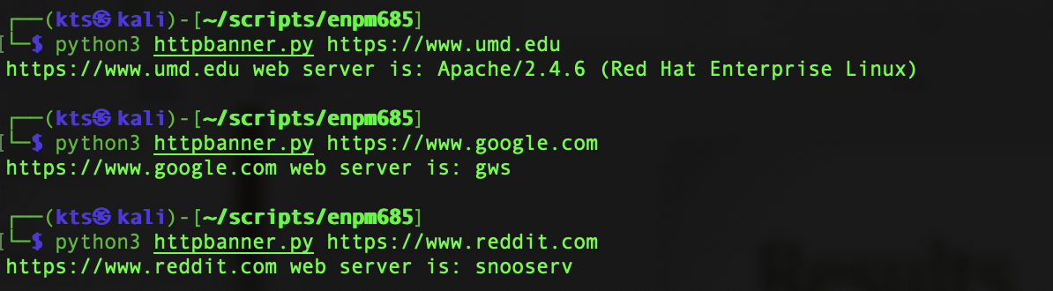
Results
What if you expand this and take a lot of web sites listed and determine what version of web server they are running on.
You could then parse that looking for vulnerable hosts (ex: You have an exploit for Apache 2.4.24 review the list for some targets.)

Slide 28
Study: Wordpress site finder
Write a script that checks to see if a site might be a Wordpress site.
Look for /readme.html
Look for /wp-admin/admin-ajax.php
Look for and output robots.txt
(might turn up other Wordpress links/interesting info)

Slide 29
Python requests module
We’ll use the requests module which make processing http requests/responses in Python easy.
http://docs.python-requests.org/en/master/
http://www.pythonforbeginners.com/requests/using-requests-in-python

Slide 30
requests
import requests
url = “http://www.umd.edu”
r = requests.get(url)
if r.status_code == 200:
print(“The URL was found.”)

Slide 31
Look for /readme.html
What’s next is wordpress-check.py

Slide 32
#!/usr/bin/python
import sys
import requests
def check_url(url):
r = requests.get(url + "/readme.html")
if r.status_code == 200:
print(url + " - FOUND -- POSSIBLE WORDPRESS SITE”)
else:
print(url + " - NOT found”)
httpsvr = sys.argv[1]
print("Checking " + httpsvr + "...”)
check_url(httpsvr)

Slide 33
#!/usr/bin/python
import sys
import requests
def check_url(url):
r = requests.get(url + "/readme.html")
if r.status_code == 200:
print(url + " - FOUND -- POSSIBLE WORDPRESS SITE”)
else:
print(url + " - NOT found”)
httpsvr = sys.argv[1]
print("Checking " + httpsvr + "...”)
check_url(httpsvr)

Slide 34
Look for /wp-admin/admin-ajax.php
We could copy and paste the code from before and change it but what if we make the code more functional so we can request different URLs with it…
Change the adding to the URL into the main body

Slide 35
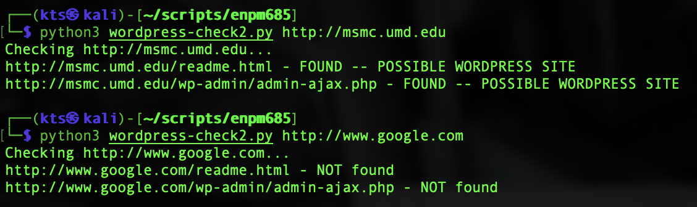
wordpress-check2.py
check_url(httpsvr)
Becomes…
check_url(httpsvr + "/readme.html")
check_url(httpsvr + "/wp-admin/admin-ajax.php")

Slide 36
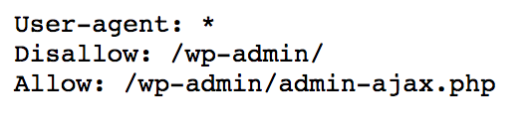
Look for robots.txt
If we find it let’s output it. Might offer more clues of Wordpress URLs or other interesting URLs…
Ex.

Slide 37
robots.txt
We could modify check_url to see if robots is in the URL or add a second variable to the function but I’m taking the easy route of duplicating check_url but changing what it does.

Slide 38
check_url
def check_url(url):
r = requests.get(url + "/readme.html")
if r.status_code == 200:
print(url + " - FOUND -- POSSIBLE WORDPRESS SITE”)
else:
print(url + " - NOT found”)

Slide 39
print_robots
def print_robots(url):
r = requests.get(url)
if r.status_code == 200:
print ("\n" + url + " - FOUND -- robots.txt content:\n")
print(r.text)
else:
print(url + " - NOT found")

Slide 40
The Final Form
wordpress-check3.py

Slide 41
#!/usr/bin/python3
import sys
import requests
def check_url(url):
r = requests.get(url)
if r.status_code == 200:
print(url + " - FOUND -- POSSIBLE WORDPRESS SITE")
else:
print(url + " - NOT found")
def print_robots(url):
r = requests.get(url)
if r.status_code == 200:
print ("\n" + url + " - FOUND -- robots.txt content:\n")
print(r.text)
else:
print(url + " - NOT found")
httpsvr = sys.argv[1]
print("Checking " + httpsvr + "...")
check_url(httpsvr + "/readme.html")
check_url(httpsvr + "/wp-admin/admin-ajax.php")
print_robots(httpsvr + "/robots.txt")

Slide 42

Go further…
Search the content of /readme.html for
The text “Wordpress”
The version
Look for other common Wordpress directories
Ex “wp-content”
…next thing you know you’ll have written your own wpscan in Python. ☺

Slide 43
Study: Tor Exit Nodes
The problem: Your organization is experiencing issues with attackers using Tor for recon and exfil work. You want to block access your network from Tor.
You can do this by blocking Tor Exit Nodes
Tor makes an exit node list available here: https://check.torproject.org/cgi-bin/TorBulkExitList.py
You can query it like so: https://check.torproject.org/cgi-bin/TorBulkExitList.py?ip=1.1.1.1&port=80

Slide 44
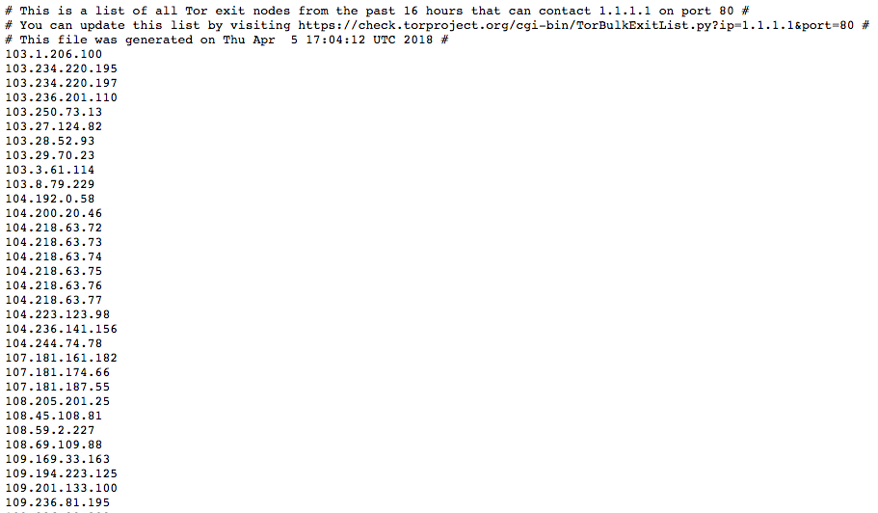

Slide 45
So now what?
How take I take this list and do something with it?
If you can export that list into a file you may be able to upload it to a blocking device (IPS, Firewall, etc.)
Or better yet programmatically and automatically do it

Slide 46
Initial script
#!/usr/bin/python3
import requests
exit_list_url = requests.get('http://check.torproject.org/cgi-bin/TorBulkExitList.py?ip=1.1.1.1&port=80')
exit_list = exit_list_url.text
exit_list = exit_list.split("\n")
exit_list.pop() # delete that last blank line
for line in exit_list:
if line[0] != "#":
print(line)

Slide 47

python exit-node.py

Slide 48
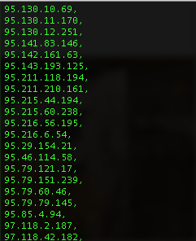
TippingPoint example
Tippingpoint needs IPs to be blocked to have a comma after them.
Let’s format our output a bit.
print line + ","

Slide 49
TippingPoint Friendly
#!/usr/bin/python3
import requests
exit_list_url = requests.get('http://check.torproject.org/cgi-bin/TorBulkExitList.py?ip=1.1.1.1&port=80')
exit_list = exit_list_url.text
exit_list = exit_list.split("\n")
exit_list.pop() # delete that last blank line
for line in exit_list:
if line[0] != "#":
print(line + ",")

Slide 50
Save as…
We could pipe this into a file for output (./exit-node.py > output.txt) but let’s write it to a file in the script
We’ll add some counting for the output to the screen so we can see something happened.

Slide 51
#!/usr/bin/python3
import requests
f = open("tor_exit_nodes.txt", "w")
exit_list_url = requests.get('http://check.torproject.org/cgi-bin/TorBulkExitList.py?ip=1.1.1.1&port=80')
exit_list = exit_list_url.text
exit_list = exit_list.split("\n")
exit_list.pop() # delete that last blank line
i = 0
print("Pulling Tor exit node list...")
for line in exit_list:
if line[0] != "#":
f.write(line + ",\n")
i = i + 1
print("Done, " + str(i) + " exit nodes")

Slide 52
Now what?
TippingPoint let’s you point it to a URL you control to pull updates to block lists from.
You could put this file on an internal web server and your TippingPoint management server will poll it to get updates
Automate all the things!

Slide 53
Command line options
import sys
sys.argv[x] where x =
0 = script name (or ‘python script’ if invoked with python)
1 = first argument
2 = second argument
N = nth argument

Slide 54
#!/usr/bin/python3
import requests
import sys
if len(sys.argv) < 2:
print("You need to specify a file name")
sys.exit(0)
f = open(sys.argv[1], "w")
exit_list_url = requests.get('http://check.torproject.org/cgi-bin/TorBulkExitList.py?ip=1.1.1.1&port=80')
exit_list = exit_list_url.text
exit_list = exit_list.split("\n")
exit_list.pop() # delete that last blank line
i = 0
print("Pulling Tor exit node list...")
for line in exit_list:
if line[0] != "#":
f.write(line + ",\n")
i = i + 1
print("Done, " + str(i) + " exit nodes")

Slide 55
optparse – Option Parser
https://docs.python.org/3/library/optparse.html

Slide 56
#!/usr/bin/python3
import requests
from optparse import OptionParser
parser = OptionParser(usage="Usage %prog [-f format] file")
parser.add_option("-f", dest="format", help="output format to use [csv ,palo, iptables]")
options, args = parser.parse_args()
if len(args) < 2:
parser.error("You need to specify a format and a file name")
sys.exit(0)
f = open(args[0], "w")
exit_list_url = requests.get('http://check.torproject.org/cgi-bin/TorBulkExitList.py?ip=1.1.1.1&port=80')
exit_list = exit_list_url.text
exit_list = exit_list.split("\n")
exit_list.pop() # delete that last blank line
i = 0
print("Pulling Tor exit node list...")
print("Output option selected: " + options.format)
for line in exit_list:
if line[0] != "#":
if options.format == "csv":
f.write(line + ",\n")
i = i + 1
print("Done, " + str(i) + " exit nodes")

Slide 57
Palo Alto - /32
Palo Alto needs IP addresses/subnets to have the CIDR block with them.
1.1.1.1/32 = 1.1.1.1

Slide 58
Cleaning it up a bit…
for line in exit_list:
if line[0] != "#":
if options.format == "csv":
line_output = line + ",\n"
elif options.format == "palo":
line_output = line + "/32\n"
f.write(line_output)
i = i+1

Slide 59
Either or….
elif (options.format == "palo") or (options.format == "cidr"):
The ”palo” and “cidr” options do the same thing. Making it flexible.

Slide 60
iptables
Format iptables -A INPUT -s ip.address -j DROP
How would you add that into the code?

Slide 61
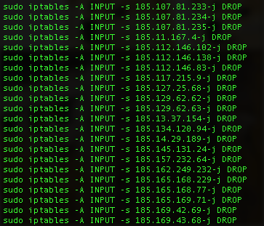
elif options.format == "iptables":
line_output = "sudo iptables -A INPUT -s " + line + "-j DROP\n"

Slide 62


Slide 63
Exercise: add ufw output
Format: sudo ufw deny from ip.address
You can do it!

Slide 64
Reference Material
The slides after this are for reference.
NOTE: They were written for Python 2, but most of the concepts should work for 3

Slide 65
Python - Variables
var = 0
var2 = “string”
var3 = [“1”, “2”]
Variables must be declared before they are used

Slide 66
Python - Variables
For some types of variables you can change their type with various functions. (str(), int(), float() …)
Ex:
var = 0
print “var is equal to “ + str(var)

Slide 67
Python – lists vs tuples vs dicts
Lists – list of values, each numbered from 0 with a value
Ex: people = [‘Bob’,‘Sue’,‘Beth’]
Tuples – lists but you can’t change their values
Ex: months = (‘Jan’,’Feb’,…’Dec’)
Dictionary – “index” of words and with each one a definition
Ex: phonebook – {‘Bob’:1112222, ‘Jenny’:8675309, ‘Joe’: 1234567}

Slide 68
Python print/get input
print “text” + var + “\n”
print “Enter something:”
input = raw_input()
input = raw_input(“Enter something: “)

Slide 69
Python – File I/O
var = open(filename)
var2 = open(“filename”, “r”)
r = read, w = write, a = append, r+ = read+write
b = binary mode, used on Windows
var.read() = reads file character by character
var.readlines() = read file line by line

Slide 70
Python – File I/O
var.write(“text”) = write to file
var.close() = close file

Slide 71
Python – Modules
Some favorite modules
csv (Process csv files with ease)
feedparser (Parses RSS feeds)
python-nmap (Do nmap-things with Python)
urllib2
socket (low level I/O socket functions)
scapy (packet crafting)
BeautifulSoup (great for web scraping)
splunklib (Interacting with Splunk)
optparse (process command line options)

Slide 72
Python – Using Modules
import sys
value = sys.argv[]
from sys import argv
value = argv[]

Slide 73
Python - Conditionals
if something == something_else:
#do something
elif something < something_else:
#do something else
else:
#do this other thing

Slide 74
Python - Loops
for line in lines:
#do something with/to each line
temp = 220
while temp > 212:
#do something
temp – temp -1

Slide 75
Python - functions
def function_name():
# do stuff
def function_name2(input_var):
#do stuff with input_var
def function_name3(var):
return var*var

Slide 76
Python References
Automate The Boring Stuff with Python by Al Sweigart – In print and (free) online - https://automatetheboringstuff.com/
http://learnpythonthehardway.org/
http://www.codecademy.com/en/tracks/python
https://theitgeekchronicles.files.wordpress.com/2012/05/scapyguide1.pdf - Guide to Scapy

Slide 77
Sites for help
Google!
Stackoverflow.com

Slide 78
Helpful Books
Automated The Boring Stuff With Python by Al Sweigart (http://automatetheboringstuff.com/ and in print too)
A Whirlwind Tour of Python - https://github.com/jakevdp/WhirlwindTourOfPython
Coding for Penetration Testers by Jason Andress and Ryan Linn
Other languages:
Learning Perl and Programming Perl – both from O’Reilly Media (the Camel books)
Programming Ruby by Dave Thomas (the Pickaxe book)

Slide 79

Helpful Books

Slide 80

Helpful Books

Slide 81

Helpful Books

Slide 82

Helpful Books

Slide 83
Next week
More Python Madness

